Slide 1
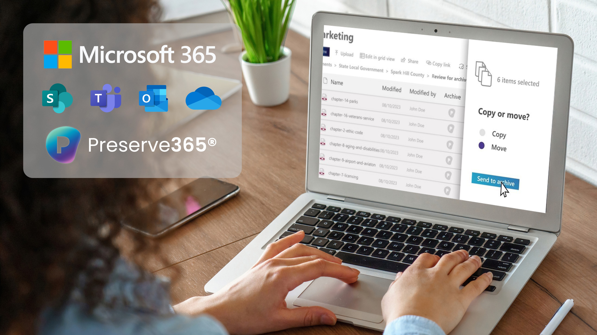


Welcome!
Managing the retention & digital preservation of long-term records in Microsoft 365
Best Practice
ARMA New England November 2024
Paul Stark
VP Sales North America
Notes:
Katie
Welcome everyone
Thank you for joining today for the Preserve365® briefing
1

Slide 2


Slide 3


Today’s focus:
Ensuring the integrity & readability of digital records over decades
Automatically transfer long-term and permanent records to preservation saving money
Vastly improving the retrieval of archived records
Access & use archived resources forever, never leaving M365
Notes:
Notes: emphasize again that we will be looking at the use of purview and retention labels to automate actions in module 2 (including guest speaker Rob Bath who will talk about converting your file plans to labels) - this session is focused on where a lot of orgs are at and gives you a lot of things you can do now to solve challenges like streamlining transfers to your archive and be more efficient and secure - with-out needing to apply or configure labels etc.
Stuart will talk to point 1
Sam will talk to point to:
What we share is grounded in to talk about how the product and the transfer/disposition processes you will show have come about i.e. grounded in customer uses (Early access group and Preview) (but no one size fits all - all orgs have different processes and polices) so will share an example that hopefully will spark ideas to see how this could be used at your org.
Module 1: Protecting and transferring long-term records
Ensuring the integrity and readability of digital records over decades
Establishing standard, secure processes for the review and transfer of records to the archive
Simplifying the retrieval of archived records
3

Slide 4






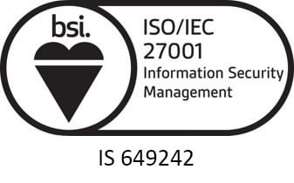






We are Preservica
Leaders in Active Digital Preservation™ archiving for compliance & long-term value protection
Instant access to trusted, actionable records over decades – independent of the originating application.
ISO 14721 OAIS
SOC 2 Type II
500M+
Collections
protected
2,000+
Preserved formats
4,000+
User organizations
Offices
Abingdon, OX
Boston, MA

Slide 5


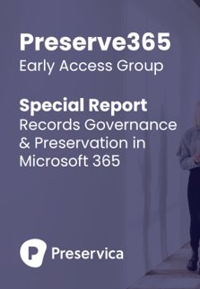





Collaborating with practitioners & Microsoft
Preserve365® ​Early Access & Preview groups:​
300+ records managers, archivists, IG & IT practitioners & leaders around the globe
Government, business & education institutions of all shapes & sizes
Working with Microsoft to make digital preservation part of the Microsoft 365 experience & ecosystem
Notes:
Michael: I added this in so you can set scene/ context that the all the best practice examples and processes we will discuss throughout the series are based on collaboration, inputs and findings of working with archivists, RMS and IG managers that have been part of our Early Access and Preview and Trial groups………..as well as the close collab with MS product/corporate teams.
However - – there is not one way of doing things - every orgs has different process and policies etc.
So use the series as an opportunity for you to get inspired or get ideas from the way others work and adapt for your org – AND work with our expert team or book an indpeth demo to see how things could work for you.
5

Slide 6

Addressing the hidden risk of long term & permanent records in Microsoft 365
Notes:
Welcome – overview of what I will cover
……the risks to long-term and permanent records – even if you are retaining them in SP or a traditional archiving system.
What best-practice technology you need to ensure the integrity and readability of these records and eliminate these risks
And how the archiving and retrieval of content can become part of the everyday SharePoint workflows
6

Slide 7
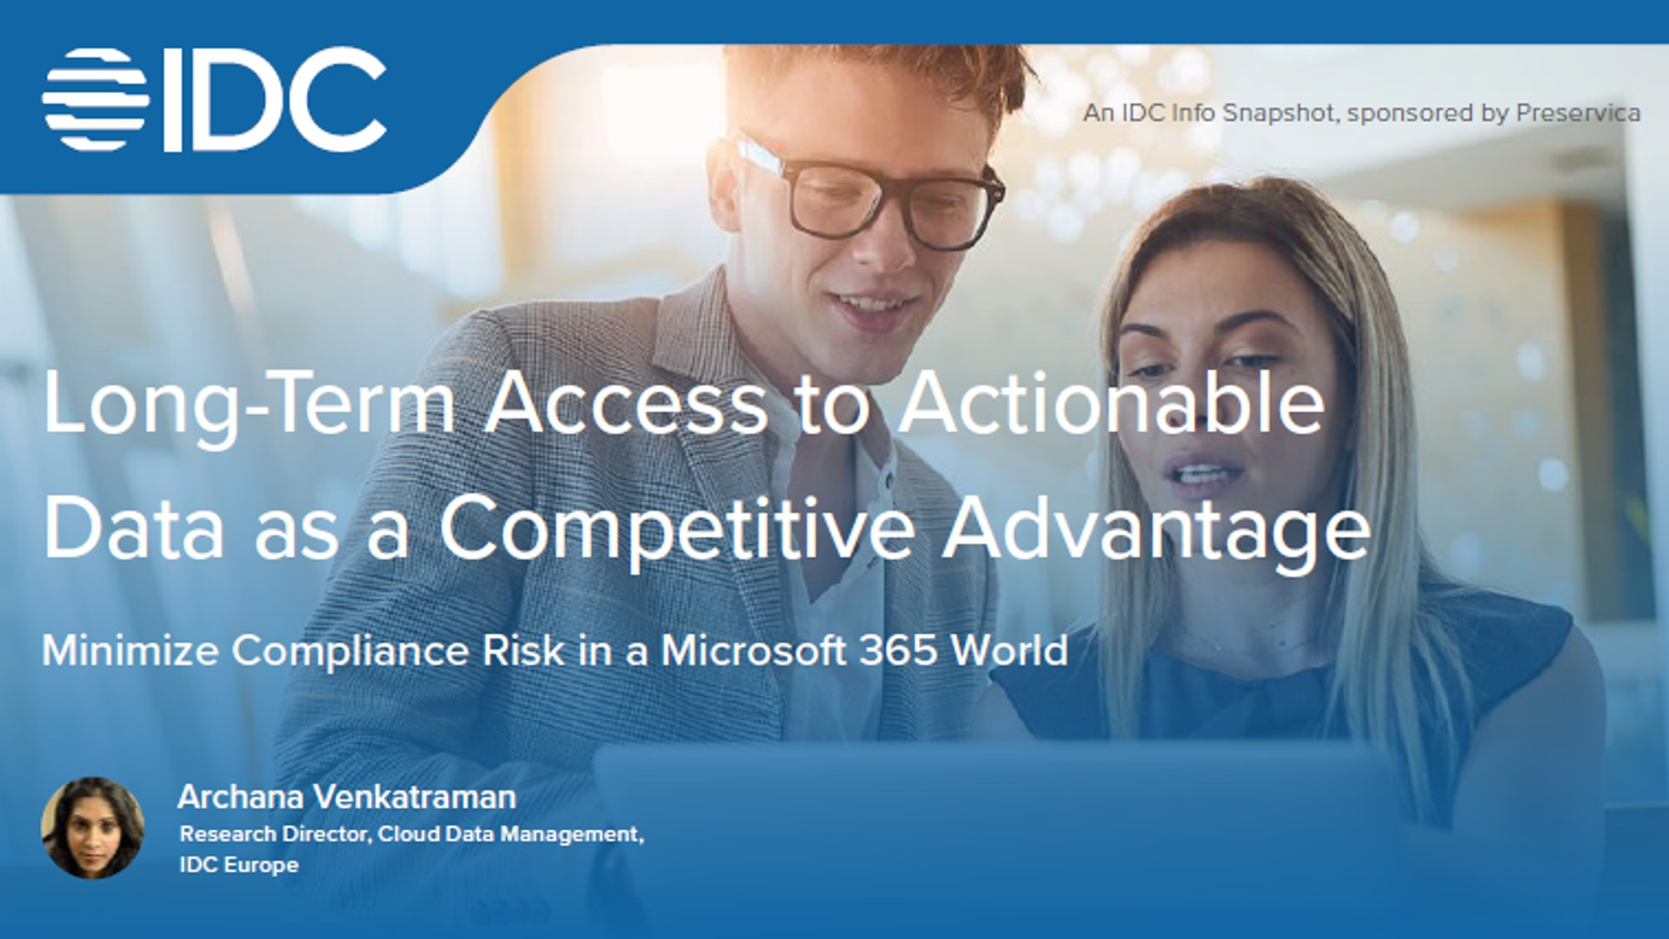







Risks to long-term data = compliance risk + loss of value
Up to 30% of data needs to be retained long-term (> 7 years) or permanently
52% of CIOs concerned about data loss from SaaS environments rate Microsoft 365 as #1 concern
Data loss & inaccessibility concerns:
Lack of policy-driven retention
Unreadable and obsolete file formats
No license or original application
Accidental or intentional change or deletion
SharePoint clutter makes search difficult
Slow retrieval from separate backup or archive
“Digital fragility has emerged as a risk to digital business, but CIOs are failing to confront it.”
Digital Fragility: The Ticking timebomb within Enterprises ​​
Notes:
7

Slide 8






Long-term & permanent records for compliance
Government
Corporate
Meeting obligations for long-term digital public records
Migrating off legacy systems to Microsoft 365
Court & criminal justice files
Board & commissioner meetings
Legislature records
Land & vital records
Health & social care
Infrastructure records
Published reports
Press releases
Policies and agreements
Strategic decision making
Market data
Insurance records
Infrastructure & maintenance records
Compliance & brand value protection
Streamlining department to archives transfers
Business strategy records
Corporate policies & communications
Infrastructure records
End-of-life SharePoint sites & projects
Strategic brand assets
Governance records
Historical images
Vital records
Audio visual recordings
Oral histories
Notes:
As we saw every type organization has LT content it needs to keep for > 7 years – Government or Corporate – You might recognize some of these – I am sure there are many more.
Infact - we did some research with a Preview group for Preserve365…
8

Slide 9




Digital Preservation ensures your long-term/permanent records can always be quickly found, trusted and actioned
Automatically maintain files in readable formats
Discoverability
Ensure integrity & authenticity with checksums
Trustworthiness
Securely store, preserve and organize
Readability
Notes:
Digital Preservation protects you against – ensuring Readability, Trustworthiness and rapid discoverability by:
Automatically maintaining files in readable formats
Ensuring integrity and authenticity with checksums
Storing, preserving, organizing, and sharing in one place
With the growing number of electronic records, there has been an increasing need to ensure these records are accessible long-term. Digital preservation, the migration and normalization of file type that are either obsolete, unreadable, or only able to be accessed using proprietary systems, is essential to help address this problem.
9

Slide 10
Establishing standard, secure processes for the review & transfer of records to the archive
Notes:
Thanks Stuart and thanks everyone for joining us, it's great to see such a large audience on the topic of standard practices for record keeping of born digital content.
With so many people representing so many different types of organisations and roles, it can be hard to find a relatable common ground to run an education session on, but from a lot of the conversations I and others in this space have had, we certainly share a goal in wanting to gain ground on managing records reliably in the behemoth that is SharePoint.
What I'm aiming to show you here is a flavour of what's possible in completing a record review and archival transfer in a way that can bring some focus and scale when capacity is stretched and you may have licensing limitations
10

Slide 11

Thank you!
Visit our website to learn more!
Paul Stark
    paul.stark@preservica.com
    preservica.com/preserve365
    @preservica
preservica.com/resources/webinar-playbacks/arma-northeastern-chapter-follow-up
Notes:
MIKE D / GARETH A
11

