Slide 1

The IG Practitioner’s Guide to Smarter Software Procurement
November 20, 2025
Notes:
Description:
Join seasoned information governance and IT professionals for a practical and engaging session on how to evaluate software solutions beyond the vendor pitch. This webinar will equip attendees with actionable strategies to assess product capabilities, identify red flags, and build a governance-focused vetting process. Whether you're selecting tools for AI, records management, privacy, or compliance, you'll leave with insights to make smarter, more confident procurement decisions.

Slide 2
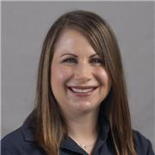
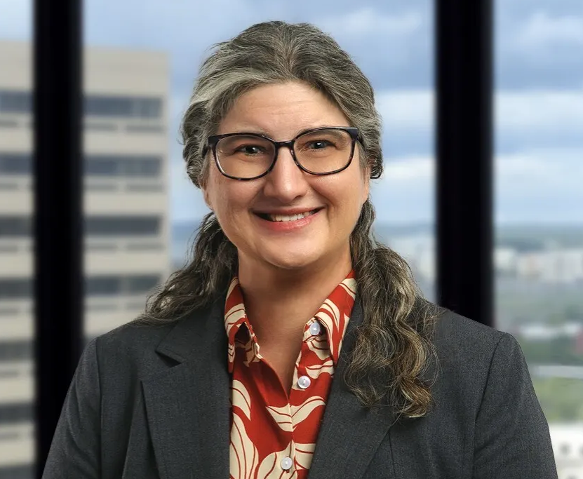
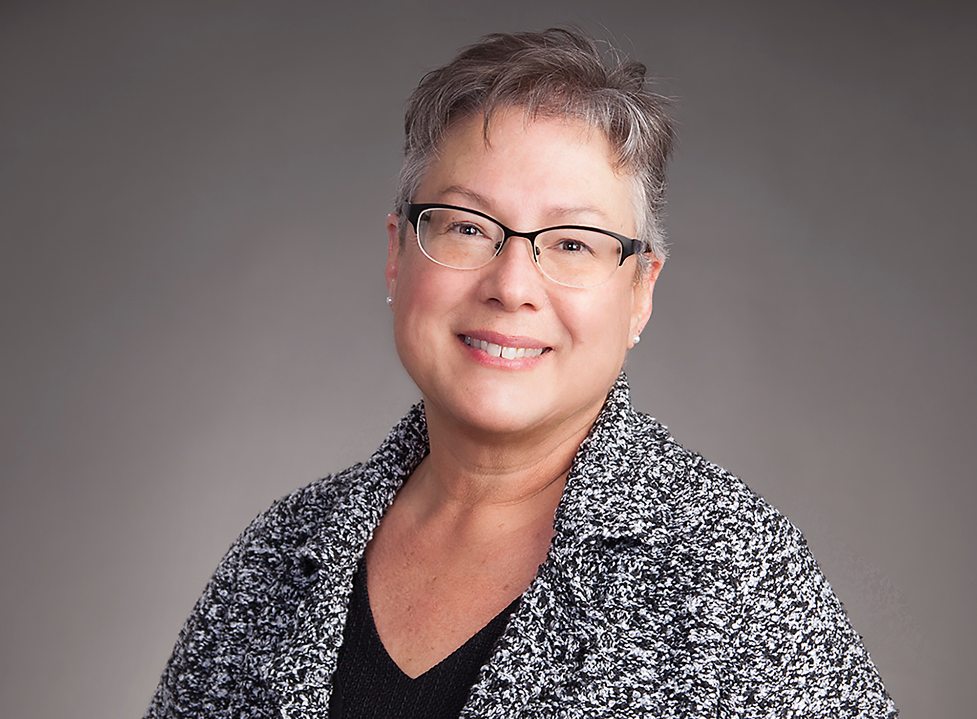
Presented By
Deanna Dumas
Sr. Manager of Information Governance
Ropes & Gray LLP
Danielle LoPiccolo
Director of Information Governance and Management
Bond, Schoeneck & King
Mary Vacherweill
Sr. Applications Analyst
ArentFox Schiff LLP
Notes:
Dani will kick things off and we will each introduce ourselves.
Danielle (Dani) LoPiccolo is the Director of Information Governance and Management at Bond, Schoeneck & King. With over 30 years of experience in the legal industry, Dani has built a career spanning both Information Technology and Information Governance. She earned her IGP certification in 2020 and has been a long-time volunteer with ILTA, contributing to the development of educational content for the annual ILTACON conference. Known for her direct, honest, and detail-oriented approach, Dani is passionate about building strong teams and sustainable governance programs.
As Senior Manager of Information Governance at Ropes & Gray LLP, Deanna Dumas leads a global team of Information Governance professionals responsible for a broad range of areas, including information governance technology, document management, records management, mobility, and end user training and adoption of technology and best practices. With over 15 years of experience at Ropes & Gray, Deanna brings a strong background in people management, project management, document and records management, end user technology training, and instructional design. Deanna holds a Master of Science in Organizational Learning and Development and is dedicated to advancing the firm’s information governance initiatives through innovative solutions, cross-functional team collaboration, and effective team leadership.
Mary Vacherweill is a Senior Applications Analyst at ArentFox Schiff LLP in the Boston area. In addition to providing tier 4 support, she lends her expertise to the planning, maintenance, configuration, and quality control of legal software applications. With an extensive background in law firm IT support, Mary brings more than 25 years of valued experience to the firm. A longtime member of the International Legal Technology Association, she is an active participant and volunteer, most recently serving in a leading role as a liaison in its Strategic Business Partner program.

Slide 3
Agenda
Introduction
Common Pitfalls in Software Vetting
Feature Validation Framework
Evaluating the Vendor’s Health & Talent
Governance-Specific Vetting Criteria
Red Flags & Due Diligence Tips
Final Checklist & Recommendations
Notes:
Dani will go through the agenda
"Vetting Software for Information Governance: Beyond the Sales Pitch"
“Be Your Own PI! The importance of Due Diligence for Software Procurement!”
Introduce the challenge of evaluating software claims and the importance of holistic vetting — not just features, but the company behind them.

Slide 4
Common Pitfalls in Software Vetting
Overpromised features that don’t exist or are underdeveloped
Misleading terminology (e.g., “AI-powered” without actual ML models)
Lack of interoperability or standards compliance
Poor documentation
Vendor lock-in disguised as “customization”
Wrong people at evaluation & troubleshooting table
Limited ability for proof of concept: controlled environment vs real life
Notes:
Mary – Over promised features
Dani – Misleading terminology
Mary – Lack of interoperability
All – Poor documentation/ no documentation
Deanna – Vendor customization: too many code changes, customizations promised by the vendor can make future upgrades to the product extremely difficult or impossible; if the developers/engineers who make the customizations leave the company, someone else supporting or untangling their code may prove impossible
Deanna – Wrong people at eval & troubleshooting table: often we may be prepping our bosses or the CIO to have the difficult conversation with the vendor and information may get lost in translation; advocate for a seat at the table, where your expertise can shine and drive the conversation, for meetings ask to have the vendor experts in the room to get into the weeds on your environment and their tech – the higher level people at the vendor don’t have the right expertise and knowledge.
Mary – Limited ability for POC, need to have a beta test in your own environment, hidden limitations if a vendor isn’t alert enough to listen to and document your requirements – they promise things not realizing you’re in the cloud or .net requirements not going to work on a server – all intertwined like puzzle pieces

Slide 5
Feature Validation Framework
Ask for demos with robust data at scale
Request technical documentation (APIs, architecture, security protocols)
Test in sandbox environments
Check for certifications (SOC 2, ISO 27001, etc.)
Interview current users — not just reference customers
Notes:
Mary - Ask for large volume of data in demos to get an idea of performance; if the demo is slow, data is messy on day of the demo – could speak to how they will handle tech issues/problems; it is perfectly OK to ask for a second demo – ask for two demos – a demo for you to ask technical questions first to dig into the weeds, and then for stakeholders once you get a baseline that the software/vendor can meet your requirements. Don’t just take their word for it.
Mary – Request tech doc and test in sandbox
Deanna – Check for certifications – checklist of your base requirements from your infosec and IG teams
Dani – chime in with aligning with info sec and not working in a silo, good communication among teams
Dani – Interview current users
Dani – tie together as a cross over of all things that all IG professionals should be aware of and know who to work with in our organizations, what frameworks already exist that you should understand, follow, and engage with them on

Slide 6
Evaluating the Vendor’s Health & Talent
Company stability: funding, profitability, leadership turnover
Talent depth: LinkedIn profiles of engineers, product managers
Support quality: responsiveness, expertise, escalation paths
Transparency: roadmap visibility, changelogs, known issues
Culture of accountability: do they admit flaws or deflect?
Notes:
Deanna: Company stability – with companies being acquired, vet the new company’s intentions and short and long-term investment plans for the acquired product, did the product SMEs and support join the new company?
Mary – Talent depth when you know you are going to be working with developers – connect with them and ask them questions to ensure expertise – be aware of this and enlist the applications professionals at your firm to do this
Dani – Talent depth – who are your future hires and how is that spread across the organization – tech, training, support, sales, team to support us and for future client on-boarding, do they outsource for any support or on-boarding
Dani – Support quality - how many support people (one engineer)? Saturation of new implementations and support issues, transparency around support
Mary – Transparency – squarely on the shoulders of the applications person at your firm – in tune with firm’s infrastructure, changes coming to the environment, known issues with frequency of MS Office updates
Mary - Roadmap visibility – second demo with stakeholders, higher ups, ask hard questions about the future of the product; are they open and transparent with issues the company is facing, shortcomings, challenges, their reaction can tell you a lot, how do they build trust with you

Slide 7
Governance-Specific Vetting Criteria
Retention & disposition controls
Audit trails & chain of custody
Metadata management
Legal hold capabilities
Privacy compliance (GDPR, CCPA, HIPAA etc.)
Security considerations for client data and cached information
Notes:
This slide is the world of IG – Dani & Deanna
Dani - When we are putting our information into a system, these are the things we should be thinking about
Data sprawl is real – as our data enters into other systems, we need to make sure we can perform our IG functions
If a new product is holding information, we need to ensure our IG functions can be managed
Deanna – add on AI of it all – our data from the DMS is getting to other applications with integrations – Hebbia, Harvey, ChatGPT, Noetic; speak to IG Risk & Compliance Intake process with IT Intake
Mary - cache considerations, in house counsel for legal issues and what is the firm’s directive, if the team looking at the product doesn’t have the dept for compliance pull the right folks in
“the pre-nup of application procurement”

Slide 8
Red Flags & Due Diligence Tips
Vague answers to technical questions
Reluctance or refusal of POC/pilot
Frequent pivots in product direction
Overreliance on buzzwords
No third-party security assessments
Lack of clarity on data ownership
Reluctance to sign BAA
Notes:
What haven’t we said yet once we get to this slide?
All red flags that would point to not going with a vendor – summary of all the things we’ve been looking for – this is a checklist of potential red flags
Deanna: can speak to recent issues with vendors not allowing test licenses for us to test their application’s performance in our own environment with our typical volumes of data. Vendor demos often use small batches of test data – we want to test at scale to evaluate performance of the application; vendor reluctance to sign BAA, vendor not having SOC 2, ISO certification

Slide 9
Final Checklist & Recommendations
Create Short, Prescreening Questions for Vendors: what are your non-negotiables?
Create a multi-disciplinary vetting & risk management team
(Security, IG, IT, Legal)
Use a standardized evaluation rubric
Require proof-of-concept or pilot
Document all vendor claims
Reassess vendors annually or post-major updates
Practitioners develop executive reporting skills. Communicate up!
Build relationships! Consultants, software developers. Not sales! ARMA and other professional
Notes:
This slide is the big takeaway – what attendees should work towards in their own organization – map to your own internal policy/workflow/framework/playbook
The to do list for attendees – plans may vary by person, but the main point is we all take these and figure out what the safest, most secure, and most efficient way to work with vendors and procure new tech
(we may be running long at this point but if not, each speak to our points)
Deanna – first bullet: speak to our ask of our InfoSec team – what are the “must haves” for a vendor for our security posture? I want to know that a vendor will at least have baseline approval from our InfoSec team before I proceed further with a vendor/application evaluation and selection. Avoids wasted time on vendor/application selection.
Deanna – second bullet: speak to our IT Intake process with InfoSec and IG review and approvals, the Architecture Review Board
Deanna – last bullet: your relationships with colleagues in your field and consultants are worth their weight in gold for the intel you’re able to obtain and share. Consultants will give you their honest opinions and what they’re hearing in the market, from other customers, etc. Your colleagues with similar projects or who are evaluating the same vendors/applications – share notes! Reach out and confirm “is this happening to you? Are you hearing X? Here are the roadblocks I’m running into” and brainstorm, push the vendors on the same issues from multiple firms – apply the pressure from multiple potential clients!
Dani – be kind to our software vendors, figure out your non-negotiables, pick the best product, no product is perfect, demonstrate you’ve done your due diligence and are recommending the best tool
Mary - there will always be compromises on both sides, don’t rely on vendors to tell your firm what to do

Slide 10
Questions?
Audience questions
Wrap up & closing
Notes:
Dani closing statement: we all do need to understand that there’s no perfect product and these tools will help you get to finding the product that works best for your organization
Deanna – look at chat/Q&A for questions

