Slide 1

How Information Governance and Privacy Complement One Another
Priya Keshav
Meru Data

Slide 2
Agenda
  Privacy is Cross Functional
  How can Privacy and IG work together
  How can Privacy and Security work together
  Foundational Elements
    Privacy by Design
    Using Common Frameworks – Privacy, Security and IG
      NIST
      ISO
  Conclusion – Promoting Cross Functional Collaboration

Slide 3
Privacy
Cross Functional - break through the “silos” of a traditional organizational structure
Privacy
Security
Data and Information Governance
Privacy needs to work Information Governance, Security, IT, and Compliance to embed robust privacy practices throughout the organization; and demonstrate real, tangible value to the business.

Slide 4



Privacy
Core Areas
Teams share similar but not completely aligned goals
  Third party risk management
  Incident Management
  Retention
  Training
  Data Mapping
  Classification
Operate independently
  Sometimes even compete for resources
.
Security
Privacy
Analytics
IG
Cross-Functional Team

Slide 5
Privacy and Information Governance
Cross Functional
Data Mapping
Cross Populate steering committees
Data Classification
Classification of PI/SPI/ PHI etc.
Defining Retention for PI
Retention
Privacy Team
Information Governance Team
DSR

Slide 6
Privacy and Security
Cross Functional
Privacy Training and Awareness
Third Party Risk Management
Access Controls
Sharing of Data and Usage of Data
PI Incident Management
Breach Response and Incident Management
Privacy Team
Security Team

Slide 7
RIM vs. Privacy
Data Mapping – Differences in Perspectives
Area | RIM | Privacy
Focus | Unstructured | Mainly Personal Information
Detail | Mainly content managed by IT (Tier 1 and 2 Systems) | All uses of PI, Sharing within and outside the with third party vendors, much broader in scope. Adtech which has been a focus for Privacy enforcements are often considered Tier 4
Classification | Broader content (aligned with security) | Regulatory and Granular – PI, SPI, PHI
Key Details | Records, Business Critical Information | Data Flows, Usage, Tracking consent and withdrawal of consent

Slide 8
RIM vs. Privacy
Data Minimization Differences in Perspectives
Area | RIM | Privacy
Focus | Records vs. Non Records | Only Personal Information
Retention | Minimum period of retention (from legal or regulatory requirements) | Delete when no longer needed.
Classification | Big buckets for simplicity | Very granular: Applies to all copies and each category of personal information collected, stored and shared
Deletion |  | Data destruction laws discuss need to securely dispose personal information (in both records and non records) Anonymization generally equivalent to Deletion

Slide 9
Strategies for Promoting Collaboration
Collaborative Compliance Efforts
Cross-Populating Steering Committees
Promoting Open Communication
Aligning Leadership Roles or Aligning Goals
Joint Presentation to Leadership
Using Common Framework

Slide 10

What is Privacy by Design?
  Privacy by Design (PbD) is a proactive measure that aims to embed the concept of privacy in all data-processing activities right from the outset.
  It is designing technology and building business processes
    while keeping the privacy of individuals and
    regulatory requirements in mind
  Privacy by Design not possible without good Governance

Slide 11

7 Principles of Privacy by Design
Proactive not Reactive; Preventative not Remedial
Privacy as the Default
Privacy embedded into design
Positive-sum not zero-sum
End-to-end security
Visibility and Transparency
Respect for user privacy
11

Slide 12

Implementing Privacy By Design
Implement privacy by design into not just software, but all projects and processes.
Software Development
IT Projects
Marketing and Adtech Projects
Procurement
Operations
Business Intelligence and/or Analytics
Finance
Human Resources

Slide 13
Challenges in Implementing Privacy by Design
Same as the challenges faced by IG
Cross Functional Teams can tackle challenges more effectively and deliver comprehensive solutions
Complexity in Legal Requirements
Technical Challenges in Implementing Privacy by Design
Cultural Issues
Economic Incentives
Digital Transformation

Slide 14
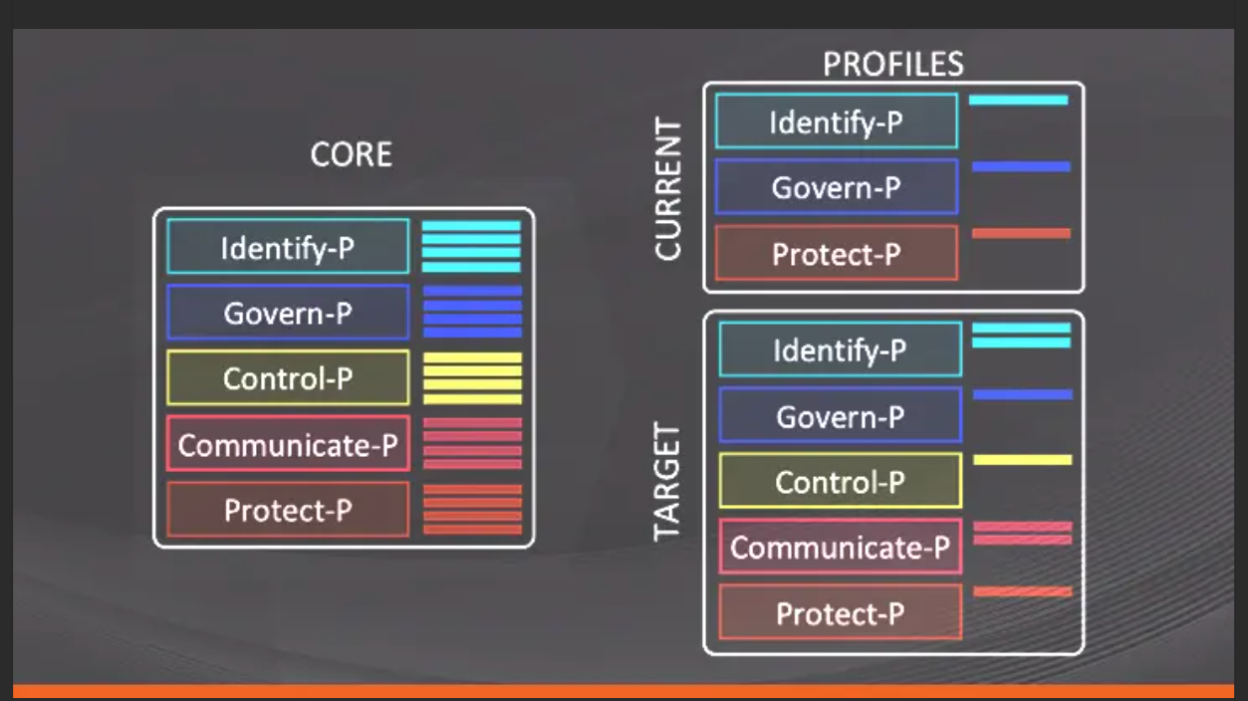
PRIVACY FRAMEWORK - NIST
Develop a framework for prioritizing the risks
  Align around common framework.
    National Institute of Standards and Technology (NIST) developed frameworks with both privacy and security considerations, which, when adopted, can help the teams speak a common language and work toward the same goals.
    NIST also published a collaboration index template to supports information security and privacy program collaboration to help ensure that the objectives of both disciplines are met and that risks are appropriately managed. A tool for information security and privacy programs to identify the degree of collaboration needed between security and privacy programs

Slide 15
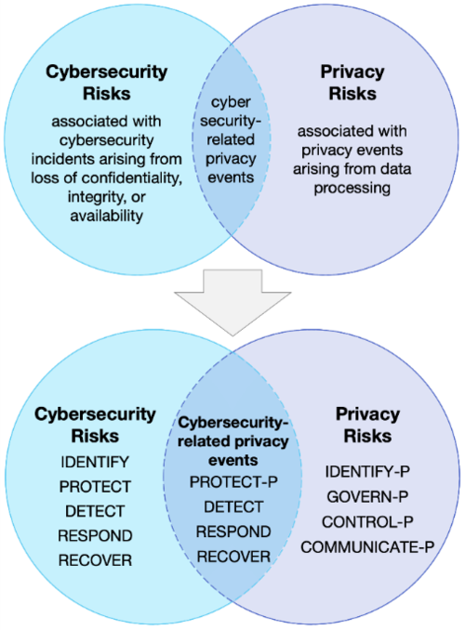
NIST Privacy Framework
The NIST Privacy Framework focuses on privacy risks and aligns them with security goals to emphasize a cross-functional collaboration approach. (https://www.nist.gov/privacy-framework)
NIST Cybersecurity Framework has helped organizations to manage cybersecurity
risk. NIST clearly identifies that managing cybersecurity risk contributes to managing privacy risk, but it is not sufficient, as privacy risks can be unrelated to cybersecurity incidents

Slide 16
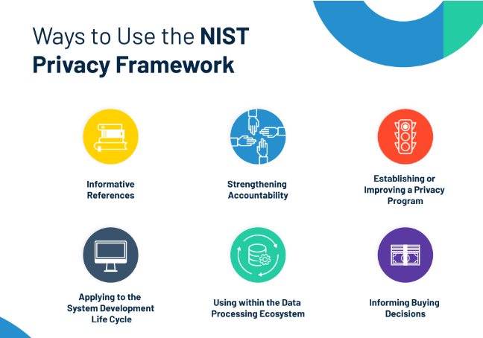
Benefits of the NIST Privacy Framework
Managing privacy risks in a systematic manner.
Meet compliance obligations
Build trust
Easy to communicate about privacy practices
Standard approach to implementation/Measurement
Identifying blind spots in implementation

Slide 17
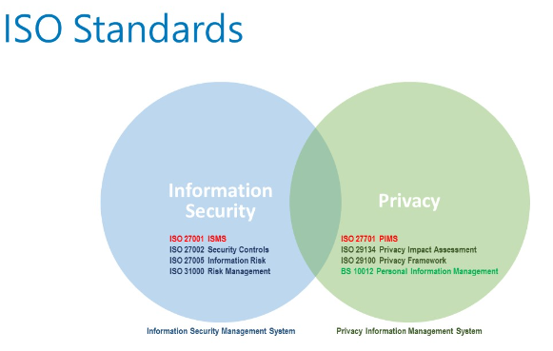
PRIVACY FRAMEWORK
Develop a framework for prioritizing the risks
  Align around common framework.
    International Organization for Standardization (ISO), has created frameworks for both privacy and security controls that can help a team work on a common goal.
    ISO 24143:2022 establishes concepts and principles for Information Governance
      Principle 5.8 ensure IG is supporting both Privacy and Security

Slide 18
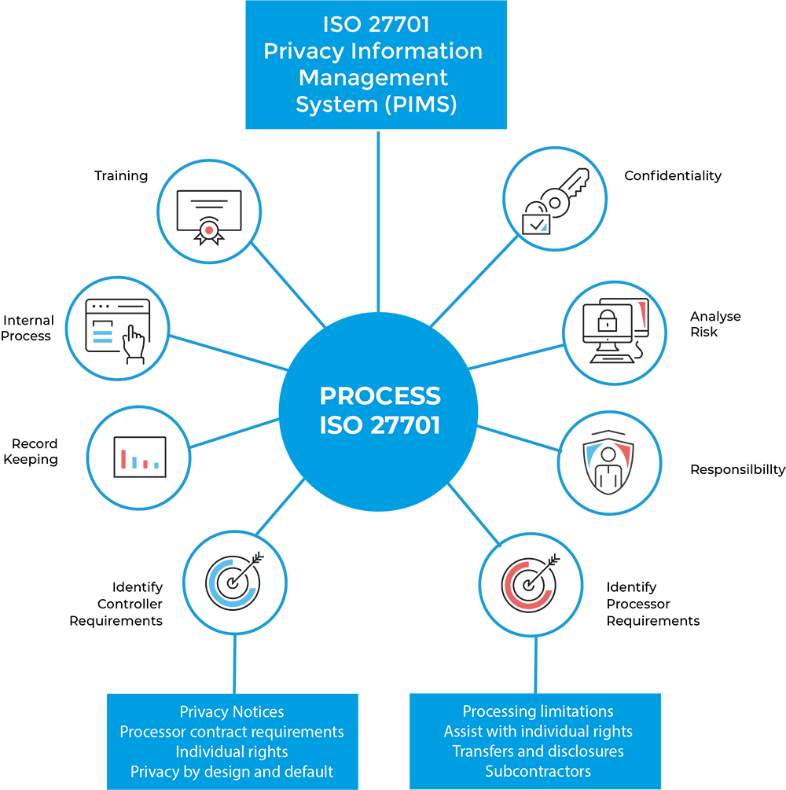
ISO PMIS
The ISO framework is known as ISO 27701 or Privacy Information Management System (PIMS).
This framework focuses on privacy principles that is divided into different sections for risk management.
Additionally, ISO provides distinction from NIST with a different framework to manage compliance in a cross-functional collaboration approach
Notes:
Source: ISO-27701-process.jpg (750×754)

Slide 19
Best Practices for Cross Functional Alignment
Common goals act as the North Star for collaboration
Keeping communications transparent and consistent
Clear understanding of the differences in objectives and goals
Sharing of resources, information if possible
Use frameworks
Notes:
Source: ISO-27701-process.jpg (750×754)

Slide 20
Thank You
Notes:
Source: ISO-27701-process.jpg (750×754)

